Slide 1

Project Title – Healthcare Analytics for Doctor Visits
[Sarthak Singh Tomar
Madhav Institute of Technology & Science]
AICTE STU ID : (STU6a3910da1bf8f1782124762)

Slide 2

PROBLEM STATEMENT
The objective of this project is to analyze doctor visits using Python and data analytics techniques. It examines the relationship between doctor visits and factors such as age, gender, income, illness, health status, insurance, and chronic conditions to identify healthcare utilization patterns through statistical analysis and data visualization.

Slide 3
Project Description
This project focuses on analyzing healthcare data to understand patterns in doctor visits using Python. It uses libraries such as Pandas, NumPy, Matplotlib, and Seaborn for data cleaning, statistical analysis, and visualization. The project examines how age, gender, income, illness, health status, insurance coverage, and chronic conditions are associated with doctor visits. The results help identify healthcare utilization patterns through data-driven insights.

Slide 4

WHO ARE THE END USERS?
Healthcare Providers: Doctors and hospitals analyzing patient visit patterns.
Healthcare Administrators: Planning and managing healthcare resources.
Researchers: Studying factors affecting healthcare utilization.
Government and Policymakers: Supporting healthcare planning and policy development.
Data Analysts: Extracting insights from healthcare data.

Slide 5

Technology Used
Programming Language: Python
Data Analysis: Pandas, NumPy
Data Visualization: Matplotlib, Seaborn
Development Environment: Jupyter Notebook / Google Colab / VS Code
Dataset Format: CSV (Comma-Separated Values)
Techniques: Data Cleaning, Exploratory Data Analysis (EDA), Statistical Analysis, and Data Visualization.

Slide 6
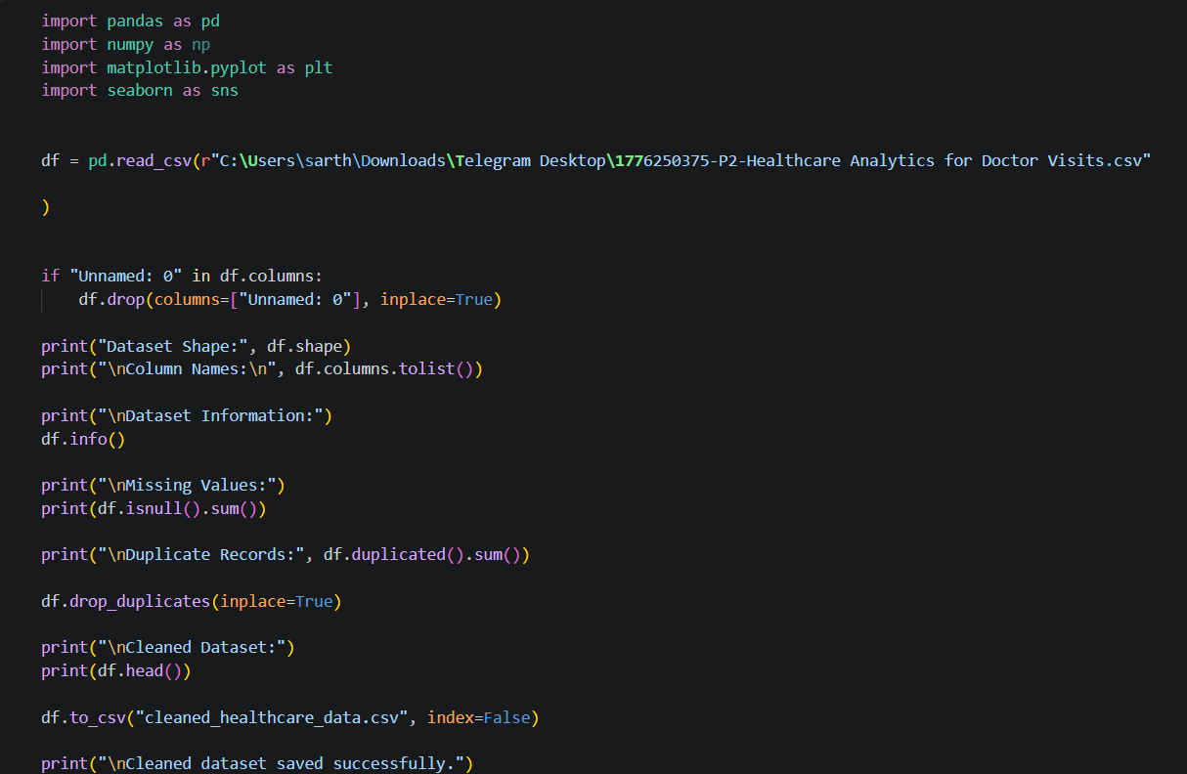
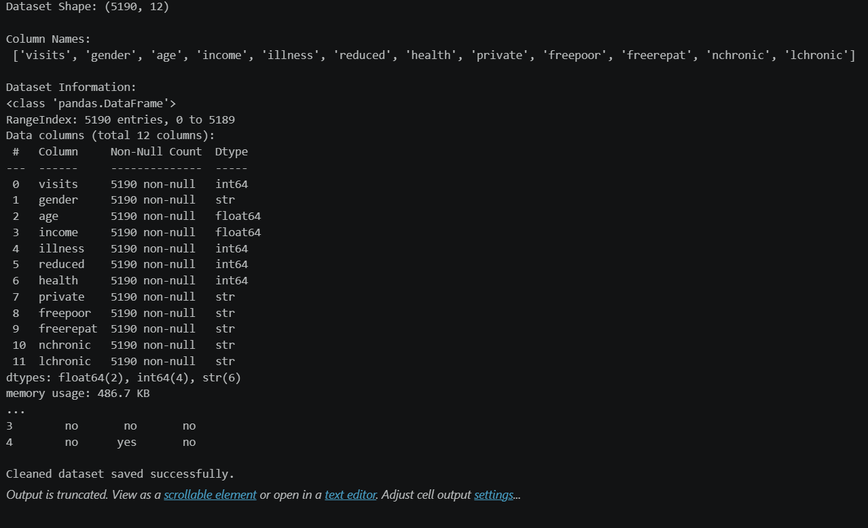
RESULTS
https://github.com/SarthakTomar2008

Slide 7
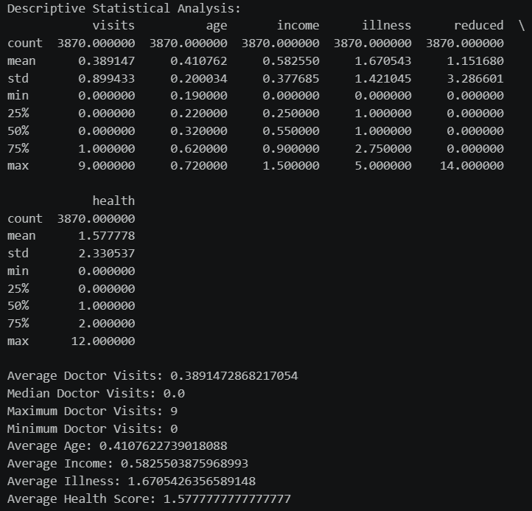
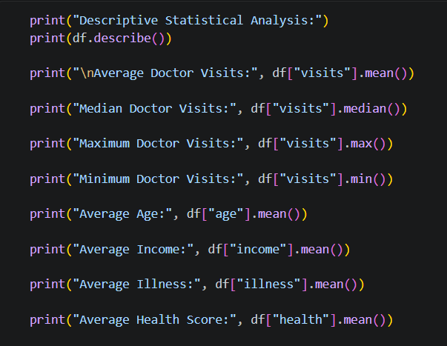
RESULTS
https://github.com/SarthakTomar2008

Slide 8
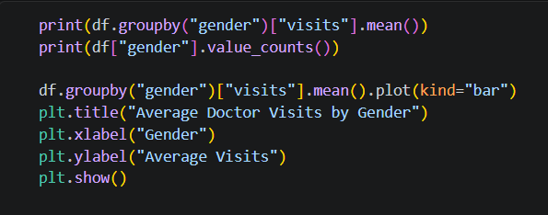
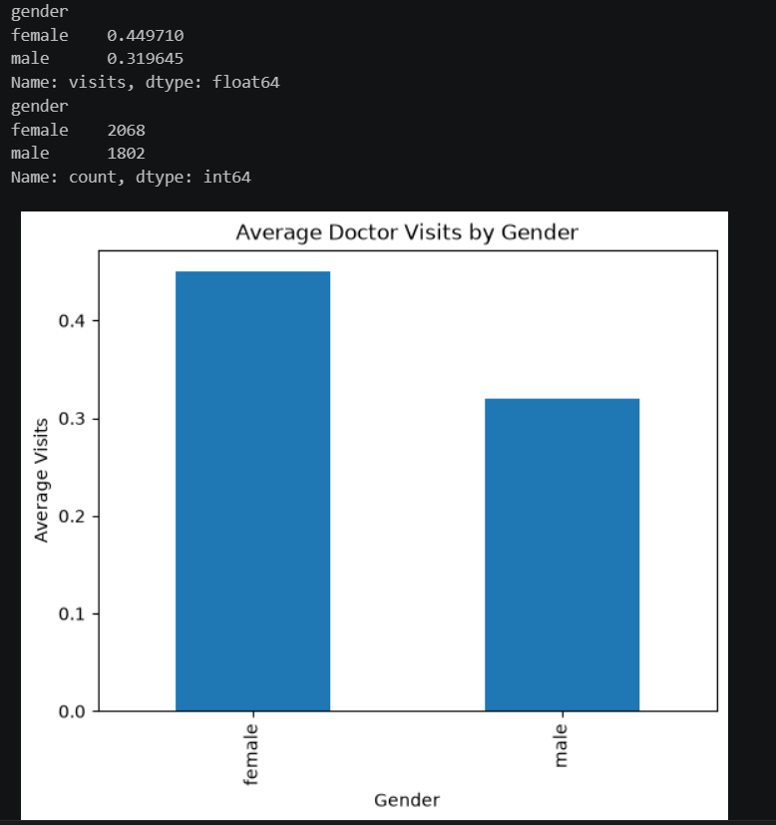
RESULTS
https://github.com/SarthakTomar2008

Slide 9
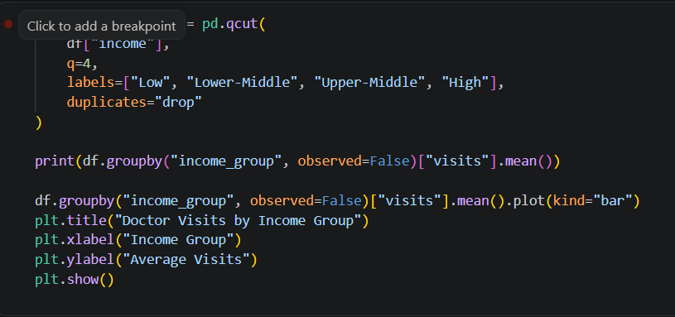
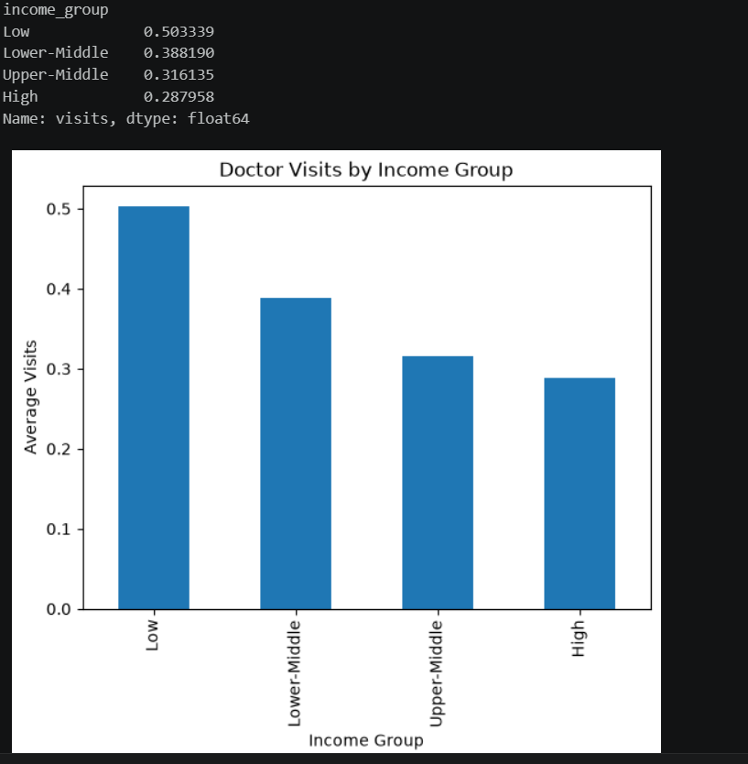
RESULTS
https://github.com/SarthakTomar2008

Slide 10
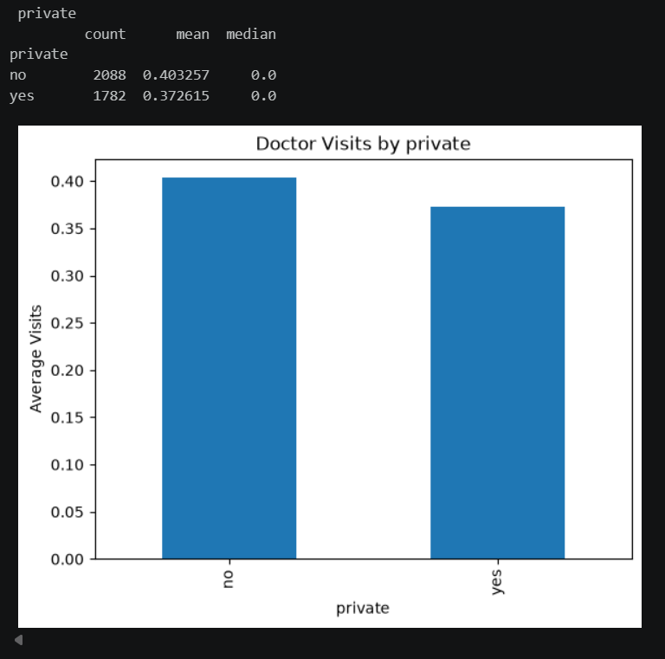
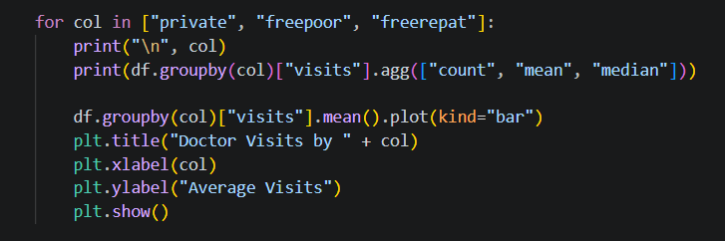
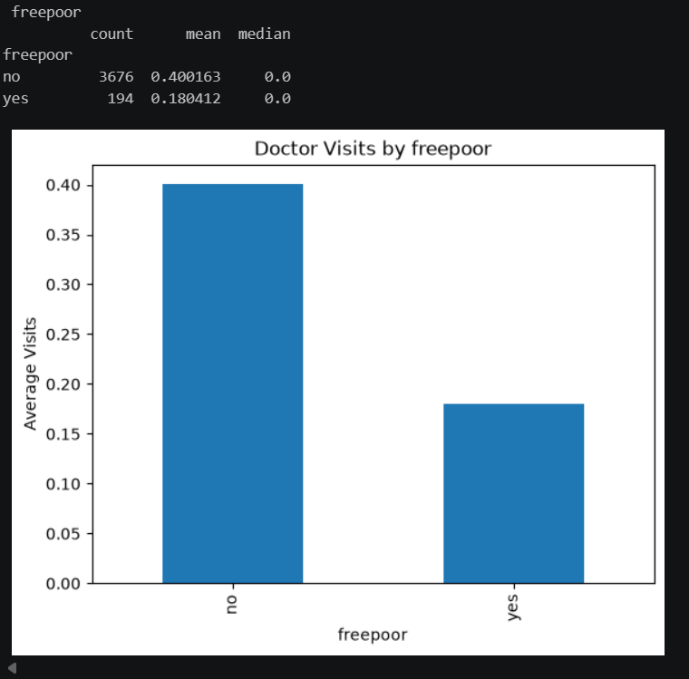
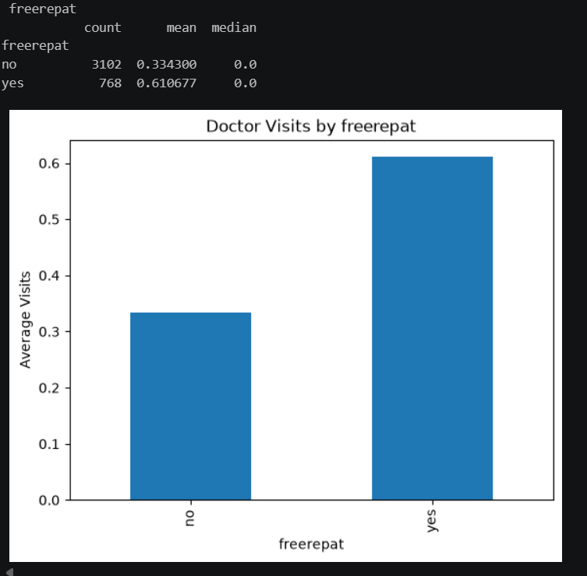
RESULTS
https://github.com/SarthakTomar2008

Slide 11
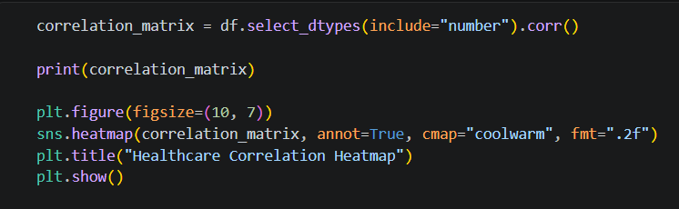
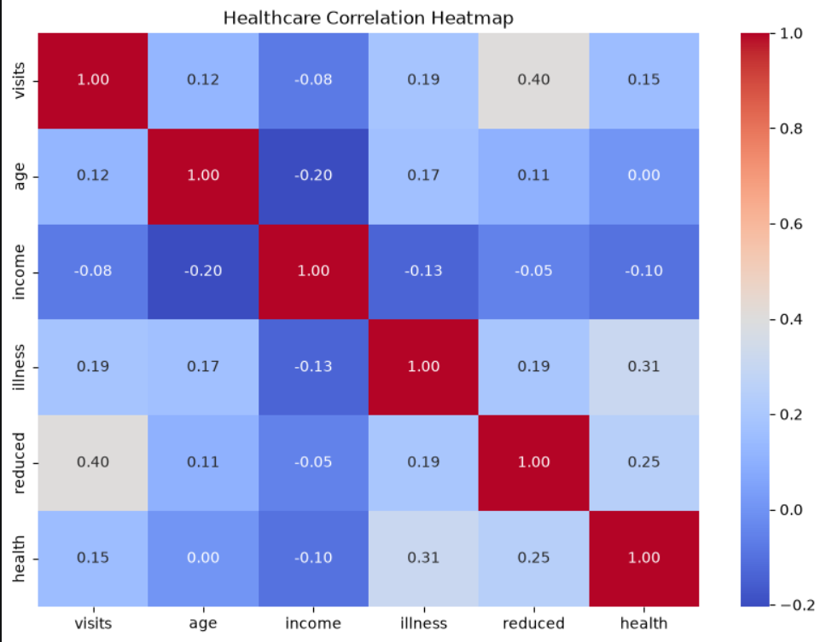
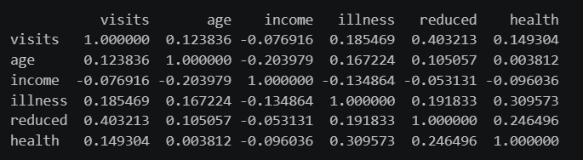
RESULTS
AND MORE….
https://github.com/SarthakTomar2008

Slide 12
Thank you
.
.

